Slide 1
Java's Collection Framework

Slide 2
Definition of collection
A collection — sometimes called a container — is simply an object that groups multiple elements into a single unit.
Collections are used to store, retrieve, manipulate, and communicate aggregate data.
They typically represent data items that form a natural group, e.g.
  poker hand (a collection of cards), a mail folder (a collection of letters), or a telephone directory (a mapping from names to phone numbers).
Notes:
You might have noticed that we have not spent a lot of time discussing arrays in Java.
In procedural languages, arrays are often the only way to represent groups of data
Array provides a mechanism for memory management
Programmer must provide algorithms for managing the array
Arrays are, generally speaking, not Object Oriented
They are not cohesive
The array and the code to manage the array are not an single unit.

Slide 3
The Need for Data Structures
Data structures organize data
⇒ more efficient programs.
More powerful computers ⇒ more complex applications.
More complex applications demand more calculations.
Complex computing tasks are unlike our everyday experience.
Notes:
You might believe that faster computers make it unnecessary to be concerned with efficiency. However…
So we need special training.

Slide 4
Organizing Data
Any organization for a collection of records can be searched, processed in any order, or modified.
The choice of data structure and algorithm can make the difference between a program running in a few seconds or many days.

Slide 5
Efficiency
A solution is said to be efficient if it solves the problem within its resource constraints.
  Space
  Time
The cost of a solution is the amount of resources that the solution consumes.
Notes:
.

Slide 6
Selecting a Data Structure
Select a data structure as follows:
Analyze the problem to determine the resource constraints a solution must meet.
Determine the basic operations that must be supported. Quantify the resource constraints for each operation.
Select the data structure that best meets these requirements.
Notes:
Typically want the “simplest” data structure that will meet the requirements.

Slide 7
Data Structure Philosophy
Each data structure has costs and benefits.
Rarely is one data structure better than another in all situations.
A data structure requires:
  space for each data item it stores,
  time to perform each basic operation,
  programming effort.
Notes:
The space required includes data and overhead.
Some data structures/algorithms are more complicated than others.

Slide 8
Data Structure Philosophy (cont)
Each problem has constraints on available space and time.
Only after a careful analysis of problem characteristics can we know the best data structure for the task.
Bank example:
  Start account: a few minutes
  Transactions: a few seconds
  Close account: overnight

Slide 9
Abstract Data Types
Abstract Data Type (ADT): a definition for a data type solely in terms of a set of values and a set of operations on that data type.
Each ADT operation is defined by its inputs and outputs.
Encapsulation: Hide implementation details.

Slide 10
Data Structure
A data structure is the physical implementation of an ADT.
  Each operation associated with the ADT is implemented by one or more subroutines in the implementation.
Data structure usually refers to an organization for data in main memory.
File structure is an organization for data on peripheral storage, such as a disk drive.

Slide 11
General comments about data structures
“Containers” for storing data.
Different data structures provide different abstractions for getting/setting elements of data.
  Queues
  Stack
  Set
Same data structures can even be implemented in different ways for performance/memory:
  queue over linked list
  queue over arrays

Slide 12
Learning to use data structures
Dual purposes for us to study Collections:
  Be able to choose, properly use built-in data structures.
  Another study in OO class design
Thus, we start by study the Collections class design.
Then, we provide many examples of how to use the built-in types in real programming.

Slide 13
Collection Framework
  A collection framework is a unified architecture for representing and manipulating collections. It has:
    Interfaces: abstract data types representing collections
    Implementations: concrete implementations of the collection interfaces
    Algorithms: methods that perform useful computations, such as searching and sorting
      These algorithms are said to be polymorphic: the same method can be used on different implementations

Slide 14
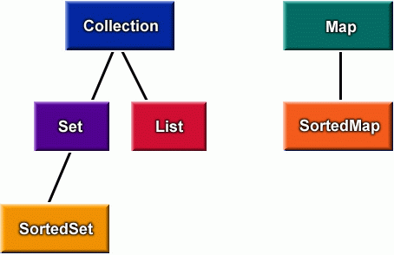
Collection interfaces
Queue

Slide 15
Collection Interface continued
Set →
  The familiar set abstraction.
  No duplicates; May or may not be ordered.
List →
  Ordered collection, also known as a sequence.
  Duplicates permitted; Allows positional access
Map →
  A mapping from keys to values.
  Each key can map to at most one value (function).
  The keys are like indexes. In List, the indexes are integer. In Map, the keys can be any objects.
  Queue →
  Ordered collection. FIFO (First In First Out)

Slide 16
Interface Collection
add(o) Add a new element
addAll(c) Add a collection
clear() Remove all elements
contains(o) Membership checking.
containsAll(c) Inclusion checking
isEmpty() Whether it is empty
iterator() Return an iterator
remove(o) Remove an element
removeAll(c) Remove a collection
retainAll(c) Keep the elements
size() The number of elements

Slide 17
Interface List
add(i,o) Insert o at position i
add(o) Append o to the end
get(i) Return the i-th element
remove(i) Remove the i-th element
set(i,o) Replace the i-th element with o
indexOf(o)
lastIndexOf(o)
listIterator()
sublist(i,j)

Slide 18
Interface Map
clear() Remove all mappings
containsKey(k) Whether contains a mapping for k
containsValue(v) Whether contains a mapping to v
entrySet() Set of key-value pairs
get(k) The value associated with k
isEmpty() Whether it is empty
keySet() Set of keys
put(k,v) Associate v with k
remove(k) Remove the mapping for k
size() The number of pairs
values() The collection of values

Slide 19
Concrete Collections
concrete implements description
collection
HashSet Set hash table
TreeSet SortedSet balanced binary tree
ArrayList List resizable-array
LinkedList List linked list
Vector List resizable-array
HashMap Map hash table
TreeMap SortedMap balanced binary tree
Hashtable Map hash table

Slide 20
Type Trees for Collections
Iterable<E>
Iterator<E>
Collection<E>
ListIerator<E>
Set<E>
Queue<E>
List<E>
SortedSet<E>
EnumSet<E>
ArrayList<E>
PriorityQueue<E>
HashSet<E>
LinkedList<E>
TreeSet<E>
LinkedHashSet<E>
Map<K,V>
EnumMap<K,V>
WeakHashMap<K,V>
SortedMap<K,V>
HashMap<E>
TreeMap<K,V>
LinkedHashMap<K,V>

Slide 21
General Purpose Implementations
 | Hash Table | Resizable array | balanced tree | linked list
Set | HashSet |  | TreeSet (sortedSet)
List |  | ArrayList Vector |  | LinkedList
Map | HashMap Hashtable |  | TreeMap (sortedMap)

Slide 22
public interface Collection
public interface Collection<E> extends Iterable<E> {
// Basic operations
int size();
boolean isEmpty();
boolean contains(Object element);
boolean add(E element); //optional
boolean remove(Object element); //optional
Iterator<E> iterator();
// Bulk operations
boolean containsAll(Collection<?> c);
boolean addAll(Collection<? extends E> c);
boolean removeAll(Collection<?> c);
boolean retainAll(Collection<?> c);
void clear();
// Array operations
Object[] toArray();
<T> T[] toArray(T[] a);
}

Slide 23
A note on iterators
An Iterator is an object that enables you to traverse through a collection and to remove elements from the collection selectively, if desired. You get an Iterator for a collection by calling its iterator() method. The following is the Iterator interface.
public interface Iterator<E> {
boolean hasNext();
E next();
void remove(); //optional
}

Slide 24
Iterate Through Collections
The Iterator interface:
interface Iterator {
boolean hasNext();
Object next();
void remove();
}
The iterator() method defined in the Collection interface:
Iterator iterator()

Slide 25
Implementations
  A collection class
    implements an ADT as a Java class
    implements all methods of the interface
    selects appropriate instance variables
    can be instantiated
  Java implements interfaces with
    List: ArrayList, LinkedList, Vector
    Map: HashMap, TreeMap
    Set: TreeSet, HashSet

Slide 26
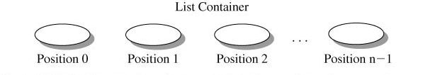
List interface
An ordered collection .
  Stores element by position
  Includes index based operation.
Allows duplicate elements.
    ordered (a sequence): there is a first, and a last element
      lists can be empty – no elements
    elements with a unique predecessor and successor
    also known as a sequence

Slide 27
Concrete List Implementations
There are concrete implementations of the List interface
  LinkedList
  ArrayList
  Vector
Which is best to use depends on specific needs.

Slide 28

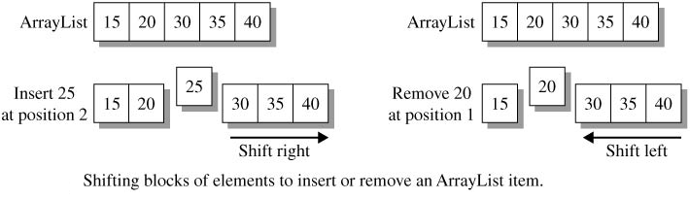
Array List
Stores element in a contiguous block of memory and automatically expandable.
The collection efficiently (O(1)) inserts and deletes elements at the rear of the list.
Operations at Intermediate positions have O(n) efficiency.

Slide 29
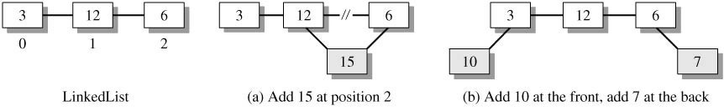
Link List
Elements have a value and links that identify adjacent elements in the sequence.
Inserting or deleting elements are O(1) operations.

Slide 30
Link list vs. Array List
Link List Array List
1. No random access 1. Fast random access
2. Fast Manipulation 2.Slow manipulation

Slide 31
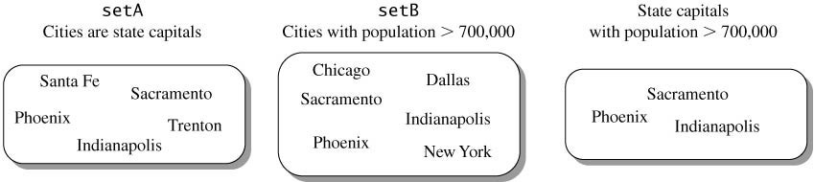
Set Interface
Set also extends Collection, but it prohibits duplicate items (this is what defines a Set).
No new methods are introduced.
Concrete Set implementations contain methods that forbid adding two equal Objects.

Slide 32
HashSets Vs Tree Set
Hash Set Tree Set
Storage method: hash table red black tree
Space used: O(n) O(n)
Put speed: O(1) O(lg n)
Iteration order: Arbitrary Sorted
Rule of thumb: Use a Tree only if you need them sorted, otherwise use a Hash
Notes:
Use hash function to map keys into positions in a hash table
Ideally
If element e has key k and h is hash function, then e is stored in position h(k) of table
To search for e, compute h(k) to locate position. If no element, dictionary does not contain e.
Keys are ID numbers (951000 - 952000), no more than 100 students
Hash function: h(k) = k-951000 maps ID into distinct table positions 0-1000
array table[1001]

Slide 33
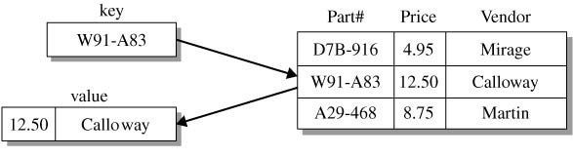
Maps
Maps are similar to collections but are actually represented by an entirely different class hierarchy.
Maps store objects by key/value pairs.
Keys may not be duplicated.
Each key may map to only one value.

Slide 34
Map Implementations
Java provides several common class implementations:
  HashMap
    A hashtable implementation of a map.
    Good for quick searching where order doesn’t matter.
  TreeMap
    A tree implementation of a map.
    Good when natural ordering is required.

Slide 35
HashMap Vs Tree Map
Hash map Tree map
Storage method: hash table red black tree
Space used: O(n) O(n)
Put speed: O(1) O(lg n)
Iteration order: Arbitrary Sorted
Rule of thumb: Use a Tree only if you need them sorted, otherwise use a Hash

Slide 36
ArrayList A Java Collection Class that Implements List
  ArrayList
    stores a collection of any type of object
    can be all the same type, or different types
    similar functionality to an array, but does not use subscripts
    is an indexed collection
  The next slide is part of Sun's documentation

Slide 37
ArrayList Java™
Resizable-array implementation of the List interface. Implements all optional list operations, and permits all elements, including null. In addition to implementing the List interface, this class provides methods to manipulate the size of the array that is used internally to store the list.
The size, isEmpty, get, set, iterator, and listIterator operations run in constant time. The add operation runs in amortized constant time, that is, adding n elements requires O(n) time. All of the other operations run in linear time (roughly speaking). The constant factor is low compared to that for the LinkedList implementation.

Slide 38
List implemented by 3 classes
// Interface name: List
// Three classes that implement the List interface:
List<String> bigList = new ArrayList<String>();
List<String> littleList = new LinkedList<String>();
List<String> sharedList = new Vector<String>();
// All three have an add method
bigList.add("in array list");
littleList.add("in linked list");
sharedList.add("in vector");
// All three have a get method
assertEquals("in array list", bigList.get(0));
assertEquals("in linked list", littleList.get(0));
assertEquals("in vector", sharedList.get(0));

Slide 39
Generics
  A List can be made to store only one type
List<BankAccount> accountList =
new ArrayList<BankAccount>();
accountList.add(new BankAccount("One", 111.11));
accountList.add(new BankAccount("Two", 222.22));
accountList.add(new BankAccount("Three", 333.33));
accountList.add(new BankAccount("Four", 444.44));
System.out.println(accountList.toString());
Output
[One $111.11, Two $222.22, Three $333.33, Four $444.44]

Slide 40
Convert to and from an Array
  import java.util.*;
  public class G{
  public static void main(String[] args){
  List<String> sun = new ArrayList<String>();
  sun.add("Feel"); sun.add("the"); sun.add("power");
  sun.add("of"); sun.add("the"); sun.add("Sun");
  String[] s1 = sun.toArray(new String[0]); //Collection to array
  for(int i = 0; i < s1.length; ++i){
  String contents = s1[i];
  System.out.print(contents); }
  System.out.println();

Slide 41
Convert to and from an Array
  List<String> sun2 = Arrays.asList(s1); //Array back to Collection
  for(String s2: sun2)
  { String s3 = s2;
  System.out.print(s3);
  }
  } }

Slide 42
Iterators
  Iterators provide a general way to traverse all elements in a collection
ArrayList<String> list = new ArrayList<String>();
list.add("1-FiRsT");
list.add("2-SeCoND");
list.add("3-ThIrD");
Iterator<String> itr = list.iterator();
while (itr.hasNext()) { System.out.println(itr.next().toLowerCase());
}
Output
1-first
2-second
3-third

Slide 43
Enhanced for loop
  If a class extends Iterable<E> (like you did with your Set<E> class), you can use Java's enhanced for loop of this general form
    for (E refVar : collection<E> ) {
    refVar refers to each element in collection<E>
    }
    example
ArrayList<String> list = new ArrayList<String>();
list.add("first");
for (String s : list)
System.out.println(s.toLowerCase());

Slide 44
Map and SortedMap
  The Map interface defines methods
    get, put, contains, keySet, values, entrySet
  TreeMap implements Map
    put, get, remove: O(log n)
  HashMap implements Map
    put, get, remove: O(1)

Slide 45
Set and SortedSet
  Some Map methods return Set
  The Set interface
    add, addAll, remove, size, but no get!
  Some implementations
    TreeSet: values stored in order, O(log n)
    HashSet: values in a hash table, no order, O(1)

Slide 46
Choosing the datatype
When you declare a Set, List or Map, you should use Set, List or Map interface as the datatype instead of the implementing class. That will allow you to change the implementation by changing a single line of code!
import java.util.*;
public class Test {
public static void main(String[] args) {
Set<String> ss = new LinkedHashSet<String>();
for (int i = 0; i < args.length; i++)
ss.add(args[i]);
Iterator i = ss.iterator();
while (i.hasNext())
System.out.println(i.next());
}
}

Slide 47
import java.util.*;
public class Test {
public static void main(String[] args)
{
//map to hold student grades
Map<String, Integer> theMap = new HashMap<String, Integer>();
theMap.put("Korth, Evan", 100);
theMap.put("Plant, Robert", 90);
theMap.put("Coyne, Wayne", 92);
theMap.put("Franti, Michael", 98);
theMap.put("Lennon, John", 88);
System.out.println(theMap);
System.out.println("------------------");
System.out.println(theMap.get("Korth, Evan"));
System.out.println(theMap.get("Franti, Michael")); }}

Slide 48
Using Sets to find duplicate elements
import java.util.*;
public class FindDups {
public static void main(String[] args) {
Set<String> s = new HashSet<String>();
for (String a : args)
if (!s.add(a))
System.out.println("Duplicate detected: " + a);
System.out.println(s.size() + " distinct words: " + s);
}}

Slide 49


Which class should I use?
The difference between the different classes is how the structure is implemented.
  This generally has an impact on performance.
Use Vector
  Fast access to elements using index
  Optimized for storage space
  Not optimized for inserts and deletes
Use ArrayList
  Same as Vector except the methods are not synchronized. Better performance
Use linked list
  Fast inserts and deletes
  Stacks and Queues (accessing elements near the beginning or end)
  Not optimized for random access

Slide 50
Which class should I use?
Use Sets
  When you need a collection which does not allow duplicate entries
Use Maps
  Very Fast access to elements using keys
  Fast addition and removal of elements
  No duplicate keys allowed
When choosing a class, it is worthwhile to read the class's documentation in the Java API specification. There you will find notes about the implementation of the Collection class and within which contexts it is best to use.

Slide 51
Data Structures | Advantages | Disadvantages
Array | Quick insertion, very fast access if index known. | Slow search, slow deletion, and fixed size.
Ordered array | Quicker search than unsorted array | Slow insertion and deletion, fixed size
Stack | Last in first out | Slow access to other items
Queue | First in first out access. | Slow access to other items
Linked list | Quick insertion, quick deletion | Slow search
Array List | Random Access | Slow insertion, deletion

